Slide 1
Configuration Management 2
SE489: DevOps Engineering

Slide 2
Outline
Why Configuration Management
What is Configuration Management
What is Puppet?
Puppet Components and Architecture

Slide 3
Why Configuration Management

Slide 4


Problems before Configuration Management
Configuring Large Infrastructure was a very hectic job

Slide 5

Problems before Configuration Management
Rollback to the previous stable version of the software was very difficult
Older version of the software stack
X
Updated version of the software
There are certain glitches with the updated software

Slide 6



Problems before Configuration Management
An application works in developer’s machine but not in testing and production. In Dev, there can be an upgraded software but old version in the Prod
Code works on my machine
There is some problem with the code
Dev
Prod

Slide 7
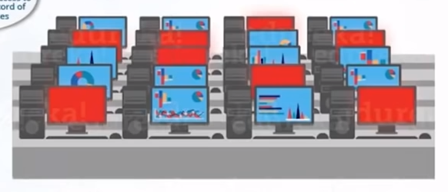
Configuration Management at NYSE
Time to rollback to the previous version of the software. Thanks to Configuration Management, we have access to accurate historical record of the software states
The 8 red marked icons are the trading terminals that are not working because of a software glitch
As a result of proper Configuration Management process, NYSE recovered from the situation in 90 minutes (very fast). What about more time!!

Slide 8
What is Configuration Management

Slide 9
What is Configuration Management?
Configuration Management is the practice of handling changes systematically so that a system maintains its integrity over time. It allows access to an accurate historical records od system states
Dev
Infrastructure as a code (IaC)
Code for the Infrastructure
Test
Provisioning of Dev, Test, Prod environment by writing code in a centralized location
Prod

Slide 10
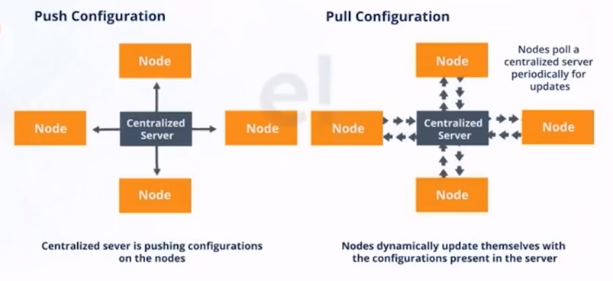
Configuration Management Components
There are two type of Configuration Management approaches

Slide 11

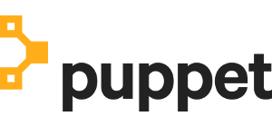
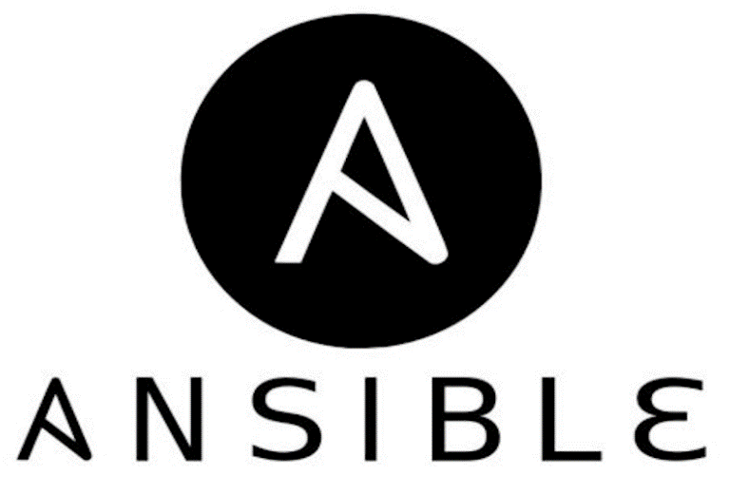

Configuration Management Tools
Pull
Push

Slide 12
What is Puppet?

Slide 13
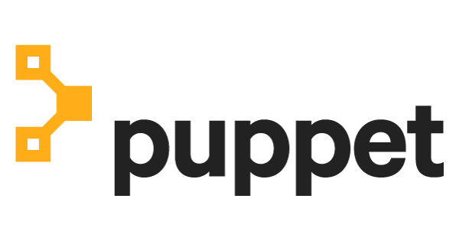
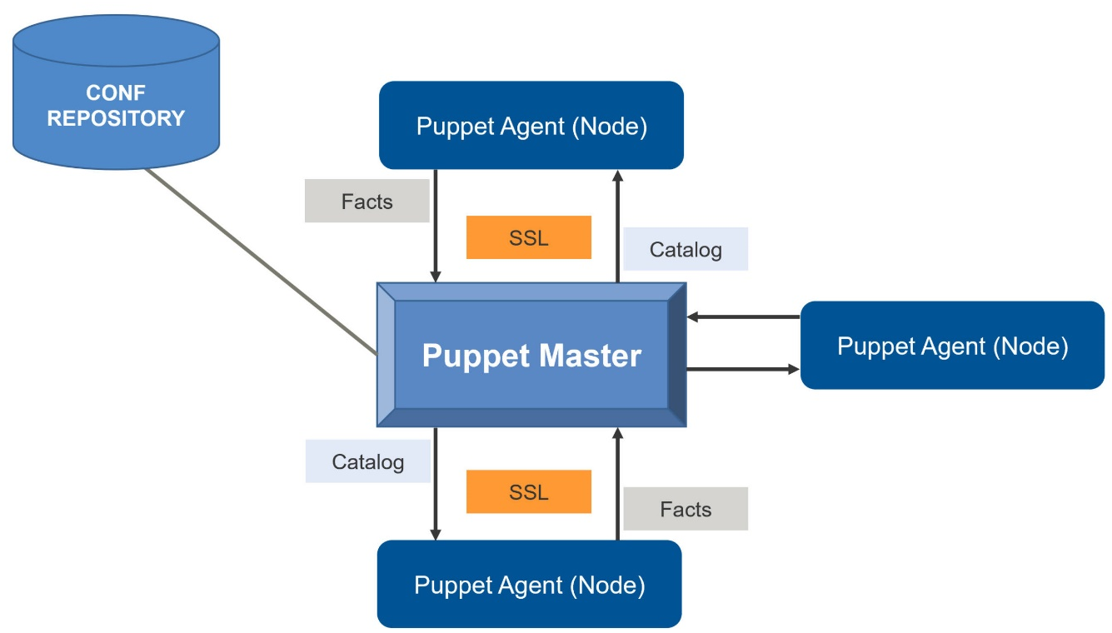
What is Puppet?
Puppet is a configuration Management tool used for:
Deploying,
Configuring and
Managing servers
It uses a Master-slave architecture

Slide 14
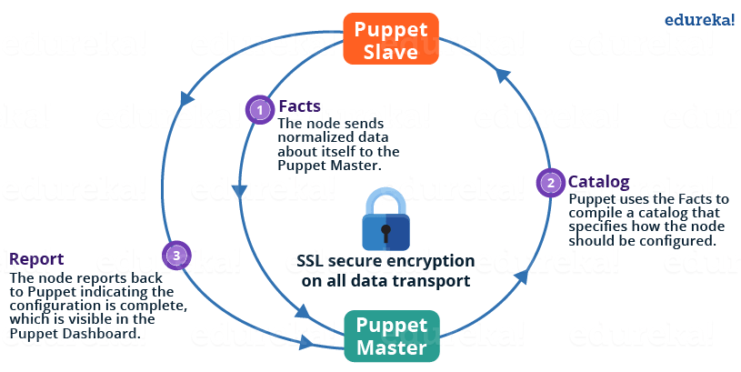
Puppet Master-Slave Architecture

Slide 15
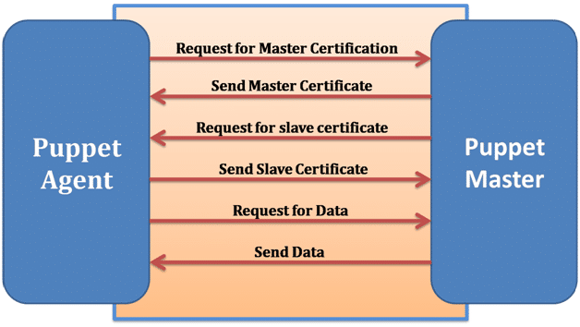
Puppet Master Slave Connection
SSL (Secure Sockets Layer) connection between Master and Slave

Slide 16
Puppet Case Study (MySQL and PHP)
Using predefined modules, download modules for PHP and MySQL
Declare these two classes in the Puppet manifests
Puppet agents will pull these configurations and both will be installed in Agents
Puppet Agent
Puppet Master
Code for PHP and MySQL
Puppet Agent
Puppet Agent
Pull the Master for changes and them pull the configurations

Slide 17
Puppet Case Study Phases
Classes and Resources
Manifests
Modules

Slide 18
Resources, Classes, Manifests & Modules
Manifests can be deployed but it is a good practice to bundle all the Manifests in the form of a Module
Resource
Resource
Resource
Manifest
Module
Class
Manifest
Manifest

Slide 19
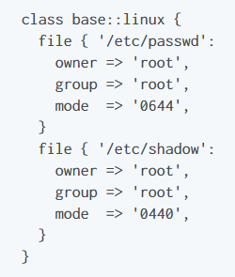

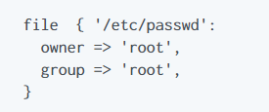
Puppet Resources and Classes
Resources are the fundamental unit for modeling system configurations. Each Resource describes some aspect of a system, like a specific service or package
Group of resources can be organized into classes, which are large units of configuration. While a resource may describe a single file or package

Slide 20
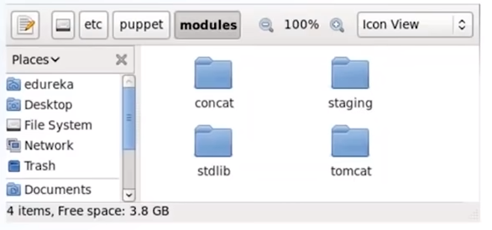
Puppet Modules
A module is a collection of manifests and data (such as facts, files, templates), and they have specific directory structure. Modules are useful for organizing Puppet code
To add a module to Puppet, place it in the etc/puppet/modules directory

